Slide 1

Major Project (CA301P)
Odd Semester
Session 2025-26
Automated Response Generation for Negative College Reviews Using Sentiment Analysis
Team Leader:-Suchita Singh 2400290140210
Team members:-
Udit Ranjan 2400290140227
Shweta Patel 2400290140204
Project Supervisor: Ms. Neelam Rawat
Ms. Shruti Aggarwal
Mr. Amit Kumar Gupta

Slide 2
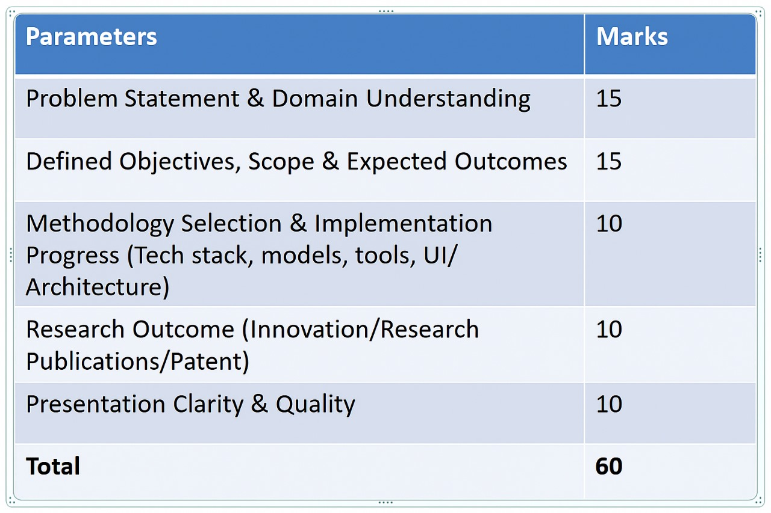
Evaluation Criteria

Slide 3
Content
Introduction
Objectives
Scope
Expected Outcomes
Methodology
Literature Review
Research Outcome
Consent Letter
Notes:
Font Styles: Times New Roman + Font Size: 25

Slide 4
Introduction
Choosing the right college is a important decision.
Students rely on online reviews (Google, Quora, Twitter, websites).
Reviews are unstructured, multilingual, and scattered.
Existing research → only binary classification, small datasets.
Few works on aspects, emotions, or automated responses.
Our project: multilingual, aspect-based, emotion-aware framework +
automated replies.
Notes:
Font Styles: Times New Roman + Font Size: 25

Slide 5
Objectives
Collect and preprocess multilingual college reviews.
Perform aspect-based and emotion-aware sentiment analysis.
Generate automated responses for negative reviews.
Build interactive dashboard for students and institutions.
Notes:
Font Styles: Times New Roman + Font Size: 25

Slide 6
Scope
Focus on analyzing student opinions for better decision-making in education.
Provide fair and transparent representation of institutional performance through
student voices.
Bridge the communication gap between students and institutions via automated
responses.
Offer data-driven insights that support quality improvement in higher education.
Lay the foundation for future research in sentiment analysis, emotion detection,
and response automation.
Notes:
Font Styles: Times New Roman + Font Size: 25

Slide 7
Expected Outcomes
Expected Outcomes: Research Paper Publication in IEEE Scopus-Indexed Conference
dataset creation, publications, patents, commercialization.
Notes:
Font Styles: Times New Roman + Font Size: 25

Slide 8
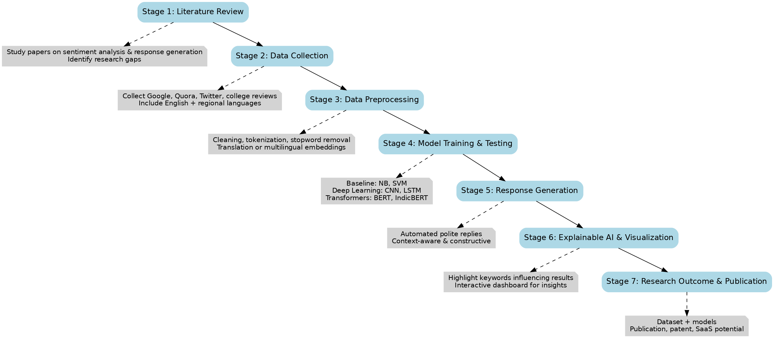
Methodology
Notes:
Font Styles: Times New Roman + Font Size: 25

Slide 9
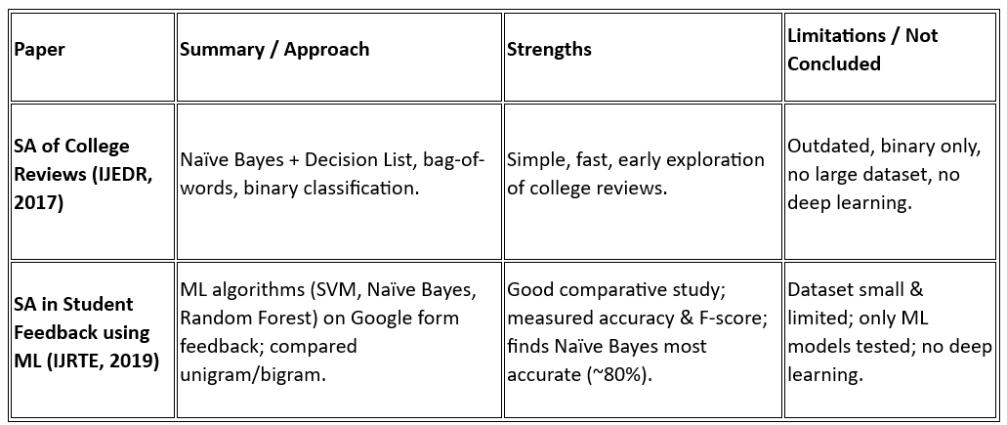
Literature Review
We studied existing research papers related to sentiment analysis in education and student feedback.
Notes:
Font Styles: Times New Roman + Font Size: 25

Slide 10
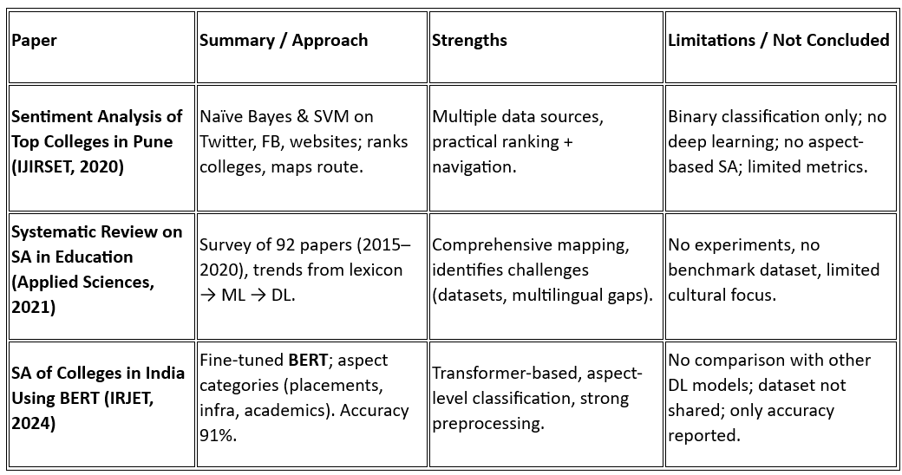
Literature Review
Notes:
Font Styles: Times New Roman + Font Size: 25

Slide 11
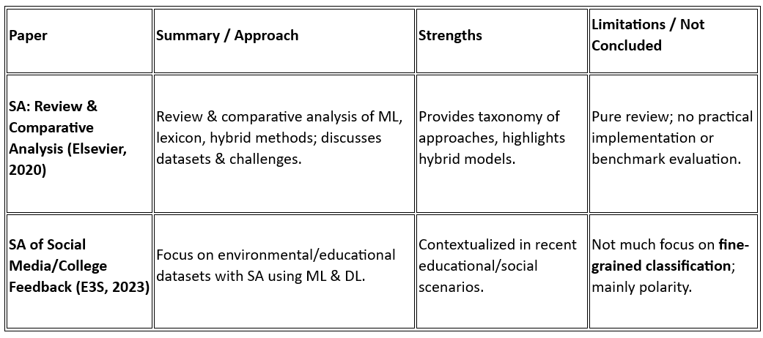
Literature Review
Notes:
Font Styles: Times New Roman + Font Size: 25

Slide 12
Research Outcome
Multilingual, aspect-based & emotion-aware framework
Automated response generation for negative reviews
New multilingual dataset for future NLP research
Higher accuracy with deep learning & transformer models
Explainable AI → transparency in results
Dashboard for insights to students & institutions
Scope for publication / patent
Notes:
Font Styles: Times New Roman + Font Size: 25

Slide 13
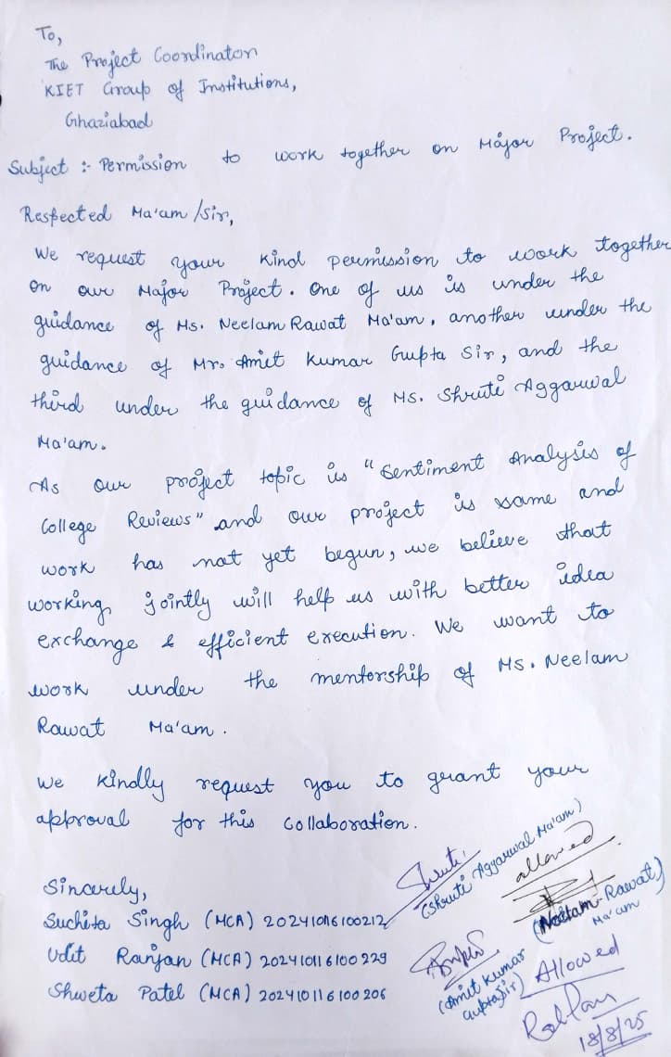
Notes:
Font Styles: Times New Roman + Font Size: 25

Slide 14

Notes:
Font Styles: Times New Roman + Font Size: 25

